Slide 1
Bootcamp Introduction & Tools Setup
Avanade ASG Data Science Bootcamp

Slide 2






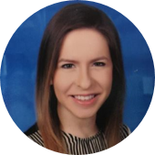
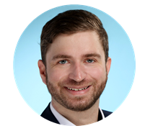

ASG Data Science Bootcamp Team
Sebastian Birk
Kavita Chopra
Mojtaba Taslimitehrani
Yi-Ting Hung
Sahana Krishna Murthy
Sowmya Prakash
Neslihan
Keskin
Bernd Carsten Mader
Kerem Öztürk
Dorith Mayer
Notes:
- Nice to work together in a bigger team of data science enthusiasts

Slide 3
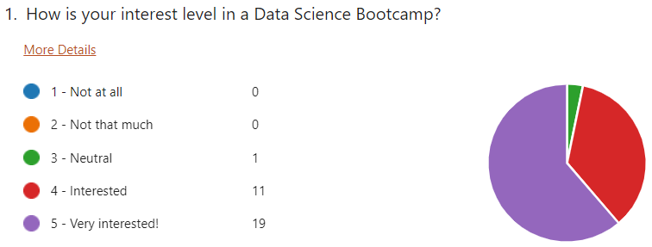
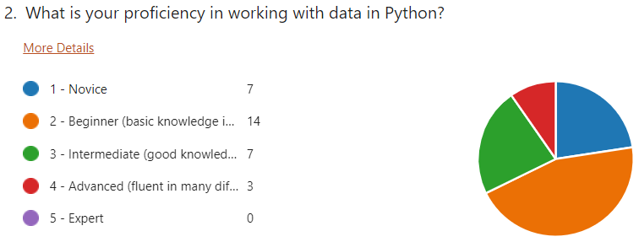
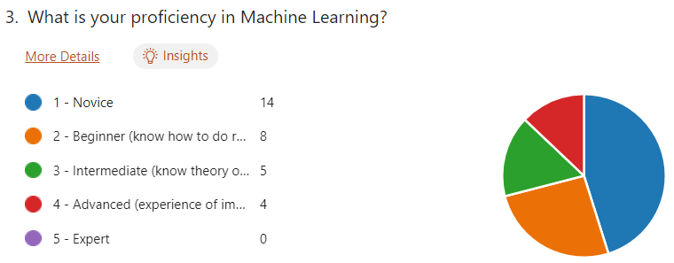
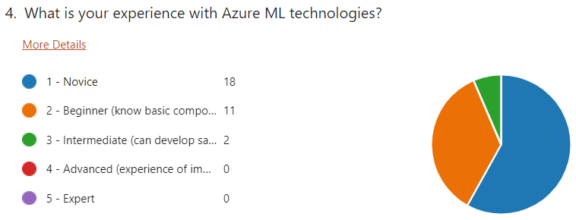
Survey Results (1/2)
Notes:
No pie charts
Biased

Slide 4
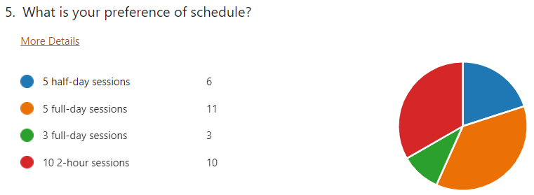
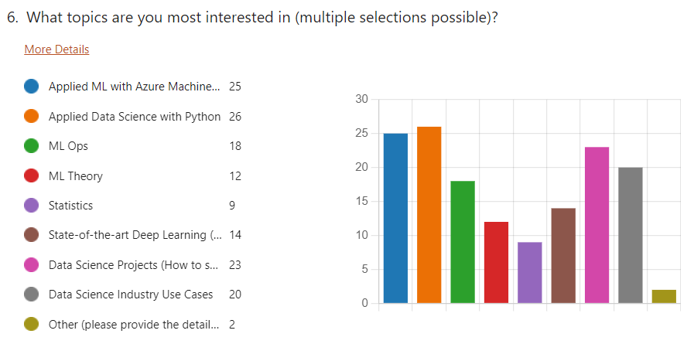
Survey Results (2/2)
Notes:
No pie charts
Biased

Slide 5
Agenda
1
2
3
4
5
6
Bootcamp Introduction & Tools Setup
7
8
9
10
11
12
Deep Learning
Sebastian – 25.07.22
Sebastian & Nesli – 19.08.22
Data Visualization with Python
Applied Data Science with Azure
Kavita, Sahana, Nesli (& Kerem) – 29.07.22
Sowmya – 22.08.22
Statistics & ML Fundamentals
Distributed Computing & Spark
Bernd Carsten & Kavita – 01.08.22
Sebastian – 26.08.22
Data Preprocessing & Feature Engineering
ML Ops
Mojtaba – 05.08.22
Mojtaba & Sebastian – 29.08.22
Supervised ML
Industry Use Cases & Project Lifecycle
Sahana & Nesli – 08.08.22 & 12.08.22
Yi-Ting – 02.09.22
Unsupervised ML
Advanced Topics Overview
Yi-Ting – 15.08.22
Nesli & Sebastian – 05.09.22
Notes:
Blue: need Azure

Slide 6
Organizational Aspects
First version of the Data Science Bootcamp will be 12 virtual 3h sessions (2.5h content + breaks) starting on 25.07. & taking place on Mondays & Fridays from 14:00 – 17:00.
The sessions will be recorded but only live participants will receive a completion certificate. There will also be certificates for partial attendance.
Individual sessions built on each other but are also self-sustained. While it is recommended to join the entire bootcamp, one can also register for individual sessions in the first version.
Future versions of the Data Science Bootcamp will be 5-day-in-person events.
We will soon release the official registration link. Stay tuned!

Slide 7
Prerequisites
Based on the survey results, the bootcamp will be more novice/beginner level and we will try to explain concepts from scratch. The prerequisites are therefore minimal.
However, some basic knowledge and experience in the following domains would be useful:
(Basic) knowledge of programming
(Basic) academic knowledge of mathematics; particularly linear algebra and calculus
(Basic) knowledge of Azure and cloud computing
Some experience with working with data
More importantly, necessary prerequisites are:
Interest in coding, mathematics and hands-on work with data
Acknowledgement that Data Science can be technical and does often not mean simply using Azure Cognitive Services and nice UIs
A rough understanding that Data Science & ML is a combination of statistics, mathematics and computer science and not magic (luckily, many intelligent people have built frameworks that abstract the math for us so the key skill we will need as applied Data Scientists is actually coding to leverage existing frameworks)

Slide 8
Scope & Objectives
Approach
It takes years of dedicated training to become a proficient Data Scientist. This is not the goal of the bootcamp. Instead, the goal is to give a high-level idea about what the field of Data Science entails, what Data Scientists do in their day-to-day work and to provide further resources for a continued learning journey
What will participants learn?
How to navigate comfortably in the applied and theoretical landscape of Data Science, Machine Learning, Statistics & Data Visualization
How to put skills into practice leveraging the Azure Ecosystem
How to set up a Data Science project from design/architecture to end of delivery
What is MLOps and how to productionize ML Models in Azure
Understand when a custom Data Science solution is needed and when Azure Cognitive Services can be used
Get to know about Avanade internal resources and accelerators
How to apply Data Science in a project team based on Avanade relevant industry use cases
What will participants not learn?
An overview of the Azure AI “out-of-the-box services” (Azure Cognitive Services) will be given but they will not be in the focus and therefore not explained in detail
Expert-level Data Science

